Slide 1

Water Quality Prediction
Review -1
Soumya.B 2203A52007
CSE AI and ML SR UNIVERSITY
0ctober 30 ,2023
Water Quality Prediction
1 / 36

Slide 2

1
Table of Contents
Introduction
About Dataset
Working on Dataset
Bootstrap Resampling
Conclusion
Result Analysis
Links
Water Quality Prediction

Slide 3
Introduction
Dataset Overview:
This dataset provides a diverse set of variables, enabling researchers to explore various aspects of water quality and develop predictive models that can aid in early detection of water quality issues and informed decision-making.
Water Quality Prediction

Slide 4
About Dataset
The Water Quality Prediction Dataset comprises a rich set of features, including but not limited to:
Water Temperature: Recorded in degrees Celsius, this parameter influences the solubility of gases and chemical reactions in aquatic ecosystems.
pH Level: Measured on a scale from acidic to alkaline, pH is a crucial indicator of water’s acidity or basicity.
Dissolved Oxygen: The amount of oxygen dissolved in water, vital for aquatic life.
Turbidity: A measure of water clarity, affected by suspended particles and sediments.
Concentration of Nutrients: Including nitrates, phosphates, and other nutrients that can impact aquatic ecosystems.
Chemical Contaminants: Data on the presence and concentration of pollutants such as heavy metals, and organic compounds.
Water Quality Prediction

Slide 5
Preparing Dataset
Pandas is a versatile library for data manipulation and analysis. You can use it to load, clean, filter, and preprocess your water quality dataset efficiently. NumPy is essential for numerical
operations and array handling. It’s often used in conjunction with Pandas for data processing.
These libraries are used for data visualization, which is crucial for understanding trends and patterns in water quality
data.Scikit-Learn provides a wide range of machine learning
algorithms for regression, classification, and model evaluation. It’s useful for building predictive models based on your water quality dataset.
Water Quality Prediction

Slide 6



Training Dataset
Perceptron Learning Logistic Regression Support Vector Machine
KNN Classifier
1
2
3
Water Quality Prediction

Slide 7






About Perceptron learning
Here are the characteristics of the perceptron learning model:
1
It is a machine learning algorithm for the supervised learning of binary classifiers.
The weight coefficient is automatically learned.
Initially, weights, and input features are multiplied. Next, the decision is made whether the neuron should be dismissed or not.
The activation function in any perceptron learning algorithm example employs a step rule to determine whether the weight functions value is higher than zero.
If the sum of all input values is higher than the threshold value, it should have an output signal; else, no output is displayed.
The linear decision boundary is plotted and it enables the distinction between the two linearly separable classes +1 and -1.
2
3
4
5
6
Water Quality Prediction

Slide 8
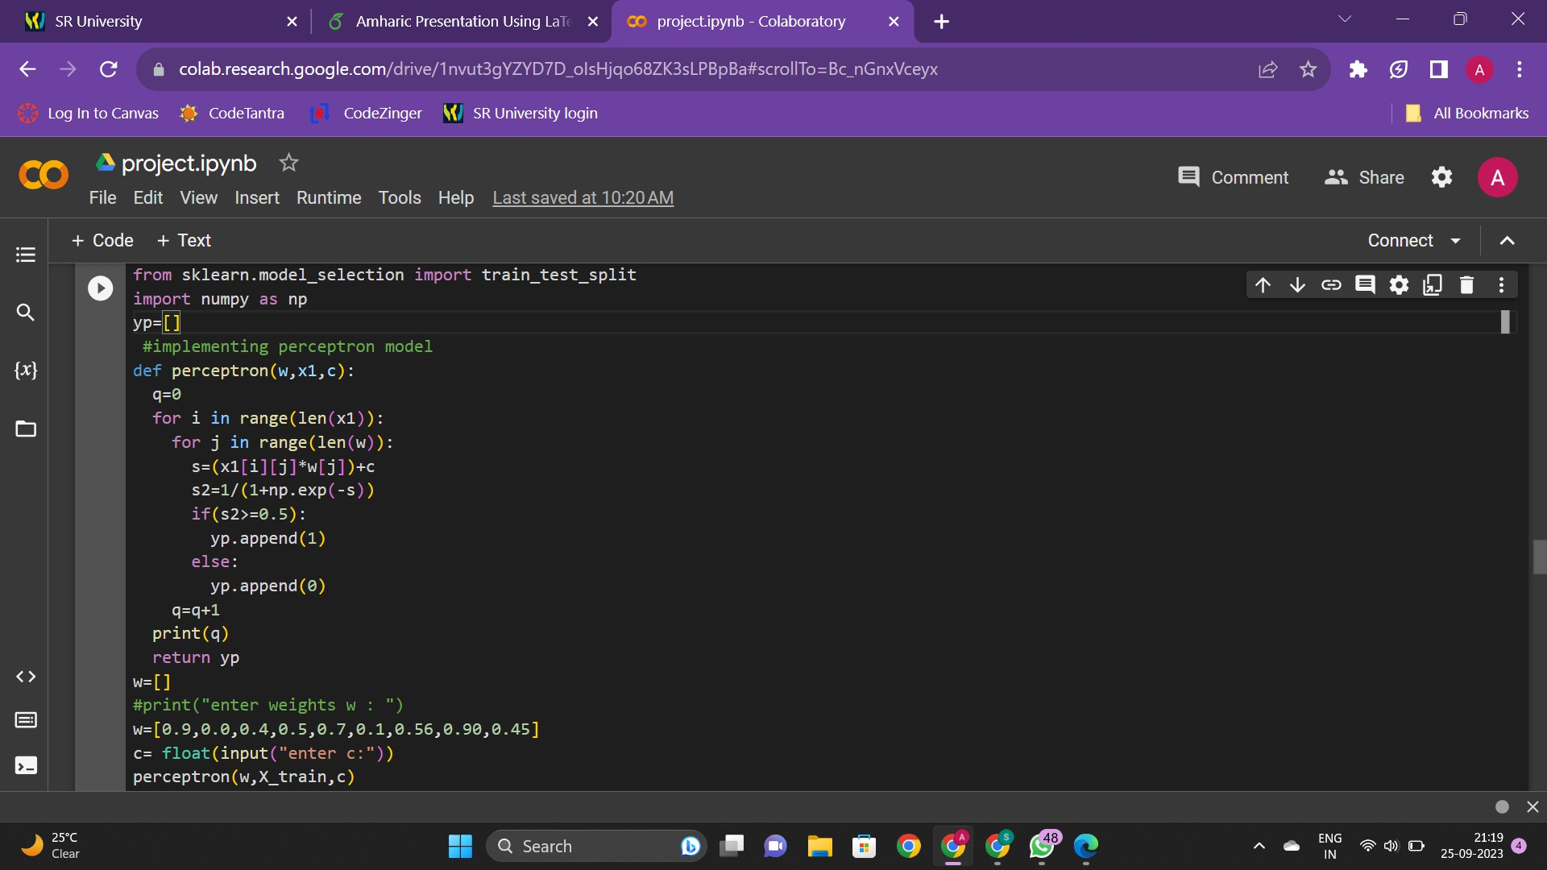
Perceptron Model
Water Quality Prediction

Slide 9
Description
Importing Libraries: The code imports the necessary libraries, including numpy and sklearn.modelselection.
Defining the Perceptron Function: The perceptron function takes in three parameters: w, x1, and b. w is a list of weights, x1 is a list of input values, and b is a bias value. The function calculates the weighted sum of the inputs and weights, applies the sigmoid function to the sum, and appends the predicted output to the yp list.
Initializing Weights: The code initializes the weights w with a list of values.
Getting Bias Input: The code prompts the user to enter a value for the bias b.
Calling the Perceptron Function: The perceptron function is called with the w, Xtrain, and b parameters.
Water Quality Prediction

Slide 10
Importing Libraries: The code imports the necessary libraries, including random.
Generating Random Weights and Bias: The code generates
random weights w and bias b values using the random.uniform() method. The random.uniform() method generates random floating-point numbers between 0.0 and 1.0
Calling the Perceptron Function: The perceptron function is called with the w, Xtrain, and b parameters. The predicted output
values are stored in the yp list.
Calculating Accuracy: The code calculates the accuracy of the predicted outputs by comparing them to the actual outputs y. The zip() function is used to iterate over both lists simultaneously, and the sum() function is used to count the number of correct predictions. The total number of predictions is calculated using
the len() function. The accuracy is calculated by dividing the
number of correct predictions by the total number of predictions. Appending Accuracy to List: The accuracy value is appended to the accuracy list.
Water Quality Prediction

Slide 11
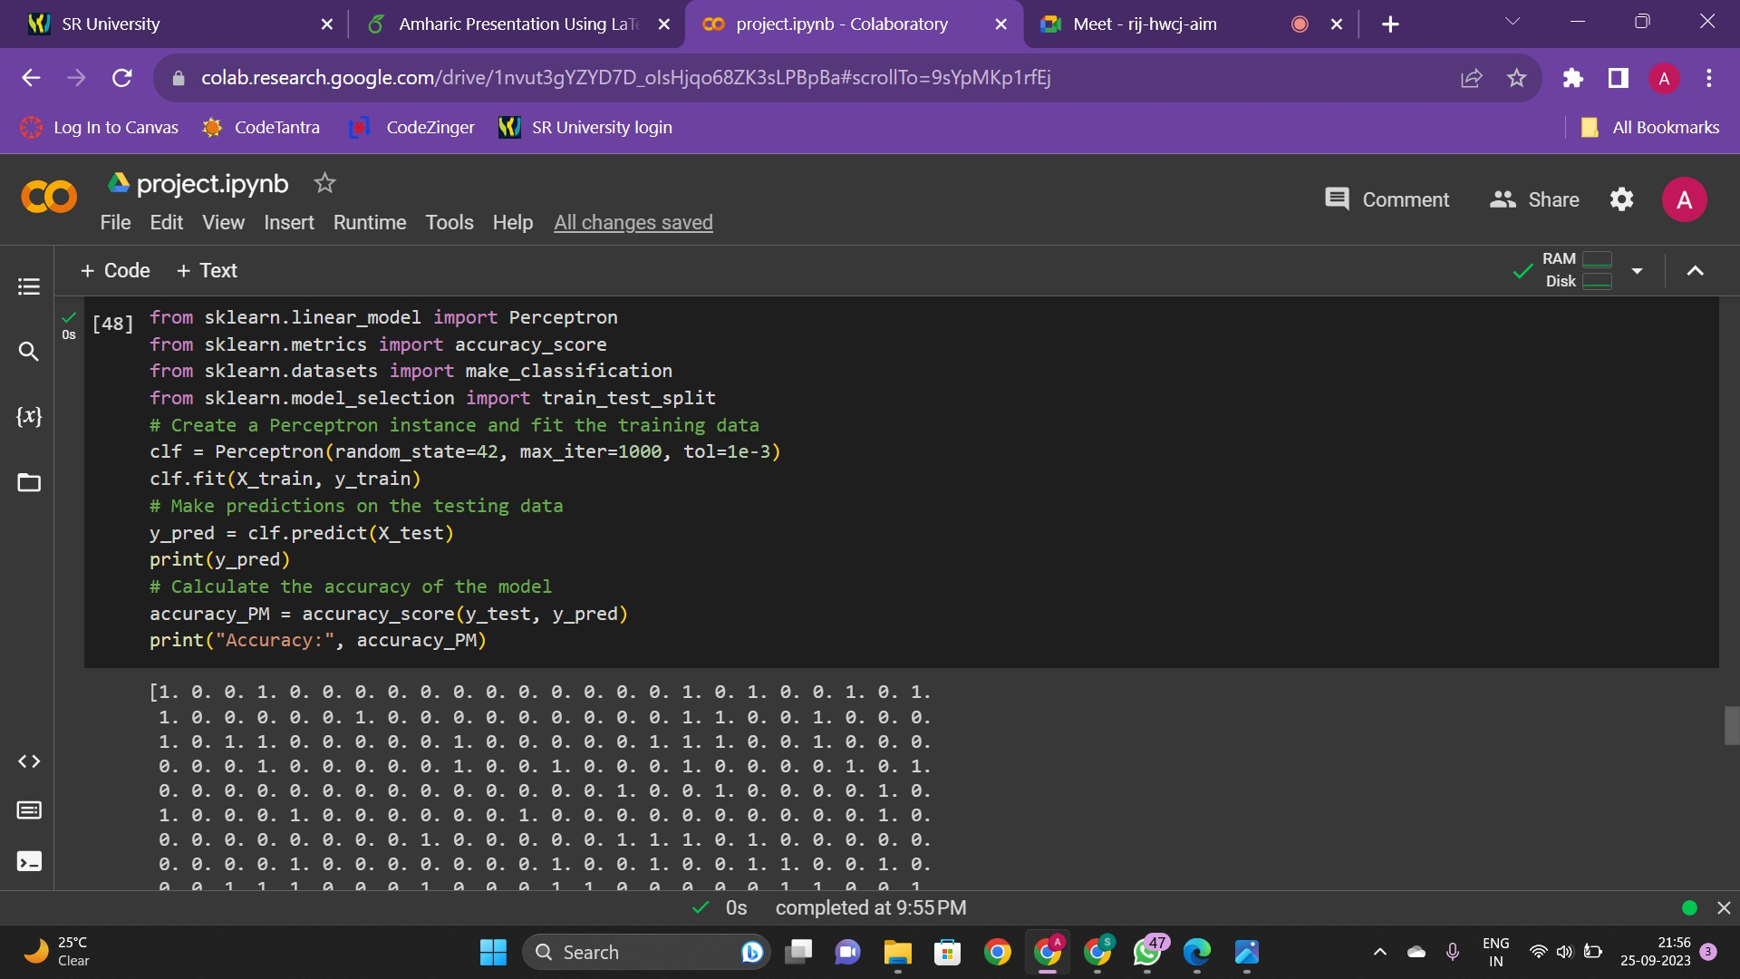
Water Quality Prediction

Slide 12
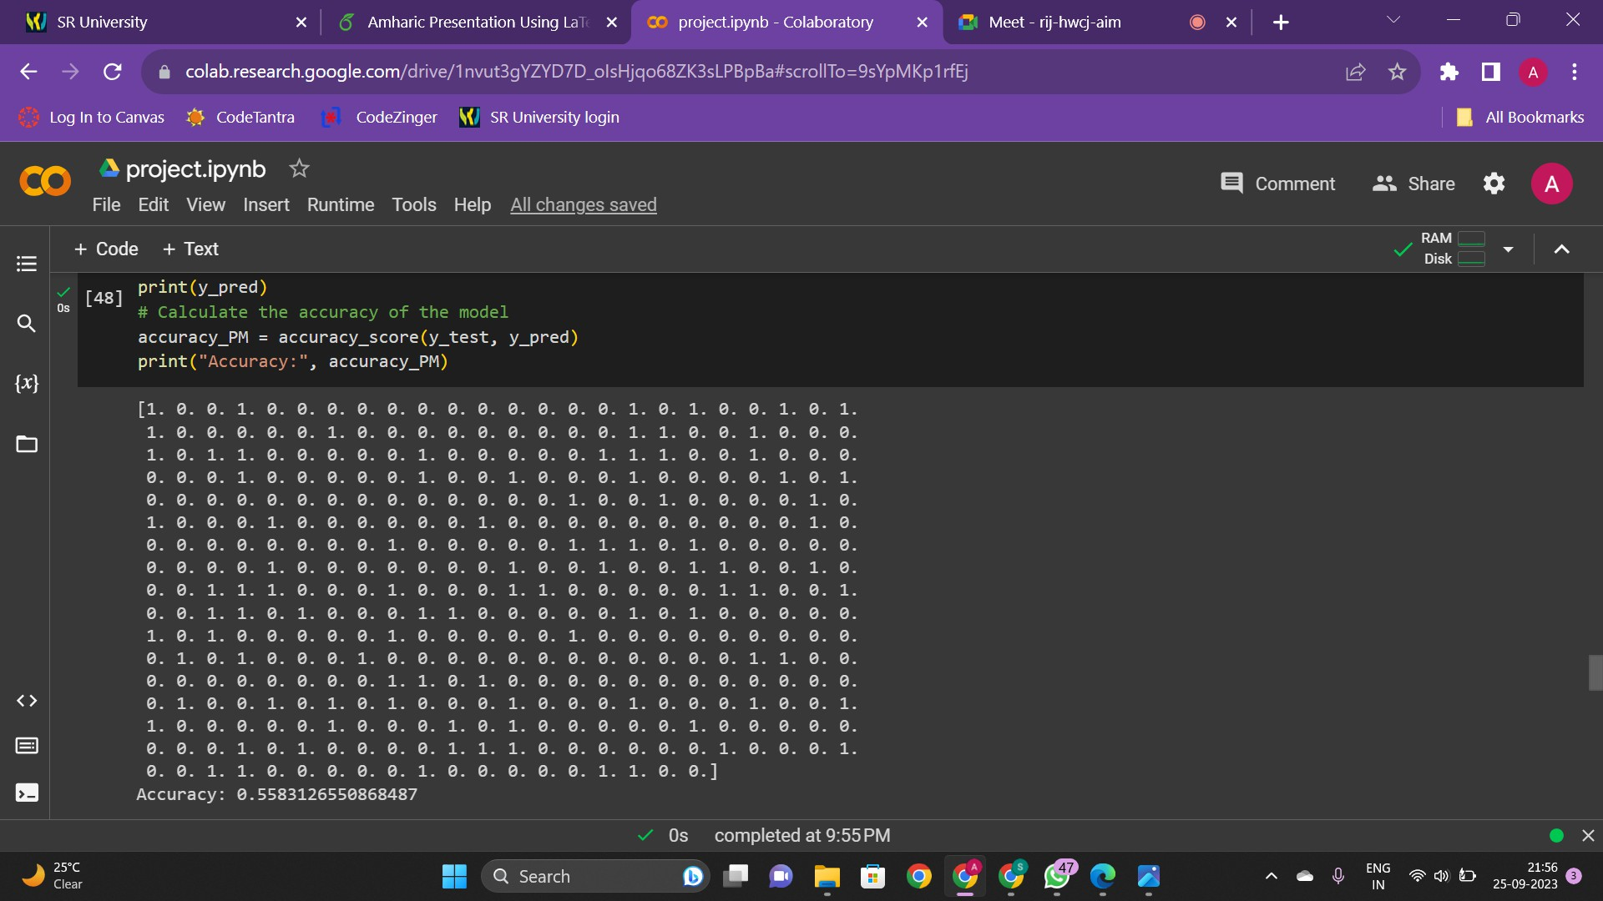
2203A52007 (SR)
Water Quality Prediction
0ctober 30 ,2023
12 / 36

Slide 13






Importing Libraries
Splitting the Data: The code splits the data into training and testing sets.
1
2
3
Creating a Perceptron Instance: The code creates a Perceptron
instance using the Perceptron() function from sklearn.linearmodel. Fitting the Training Data: The fit() method is called on the Perceptron instance with the Xtrain and ytrain parameters to fit
the training data.
Making Predictions: The predict() method is called on the Perceptron instance with the Xtest parameter to make predictions on the testing data. The predicted output values are stored in the ypred variable.
Calculating Accuracy: The code calculates the accuracy of the predicted outputs by comparing them to the actual outputs ytest.
The accuracyscore() function from sklearn.metrics is used to
calculate the accuracy. The classification report() function from
4
5
6
sklearn.metrics is used to generate a report of the precision, recall, f1-score, and support for each class.
Water Quality Prediction

Slide 14



About Logistic Regression
1
Logistic regression is a statistical approach and a machine learning algorithm used for classification problems where the goal is to predict the probability that an instance belongs to a given class
It is a classification technique borrowed from the field of statistics that uses a logistic function to model the dependent variable,
which is dichotomous in nature.
Logistic regression is easier to implement, interpret, and very efficient to train. It is very fast at classifying unknown records
Logistic regression is used when the dependent variable is in categorical form and there could only be two possible classes.
2
3
4
Water Quality Prediction

Slide 15



Logistic Regression
1
The code starts by importing the NumPy library and initializing two empty lists, costs list and num iter.
The Logisticregression class is defined with two parameters, learning rate and num iterations, which are set to 0.01 and 1000, respectively, by default.
The sigmoid function is defined, which takes a parameter z and returns the sigmoid of z.
The cost function function is defined, which takes two parameters, X and y. It calculates the cost of the logistic regression model using the sigmoid function and returns the cost.
2
3
4
Water Quality Prediction

Slide 16


The fit function is defined, which takes two parameters, X and y. It initializes the weights and bias to zero and iterates over the number of iterations specified. In each iteration, it calculates the
sigmoid of the dot product of X and the weights plus the bias. It then calculates the derivative of the weights and bias and updates them using the learning rate. It also calculates the cost of the model and appends it to the cost history list. The cost is printed every 100 iterations.
1
2
The predict function is defined, which takes a parameter X. It calculates the sigmoid of the dot product of X and the weights
plus the bias and returns the predicted values. Snippet of code is shown below:
Water Quality Prediction

Slide 17
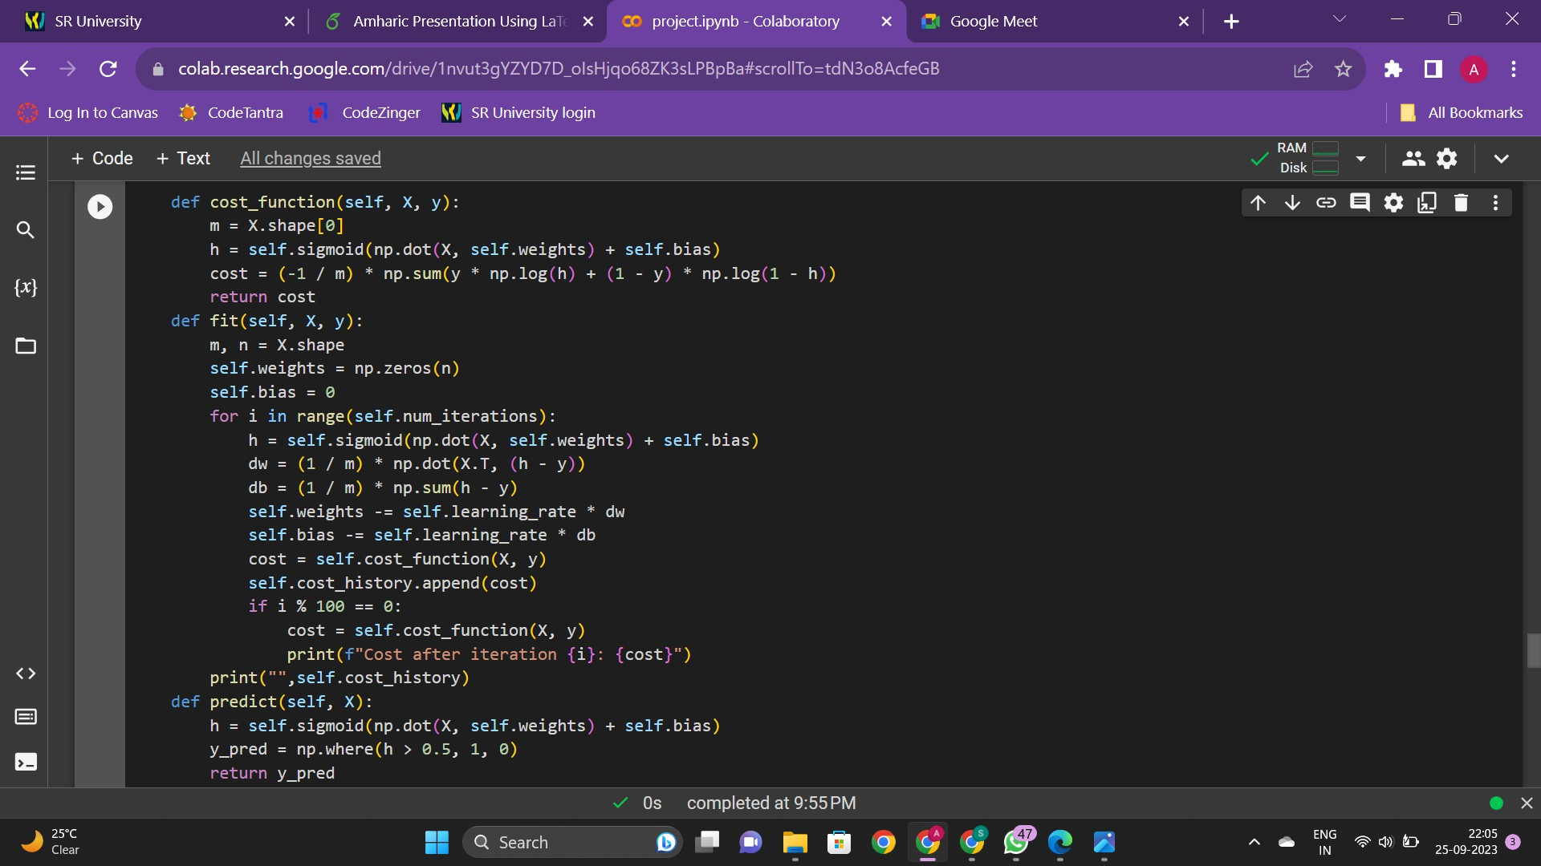
Water Quality Prediction

Slide 18
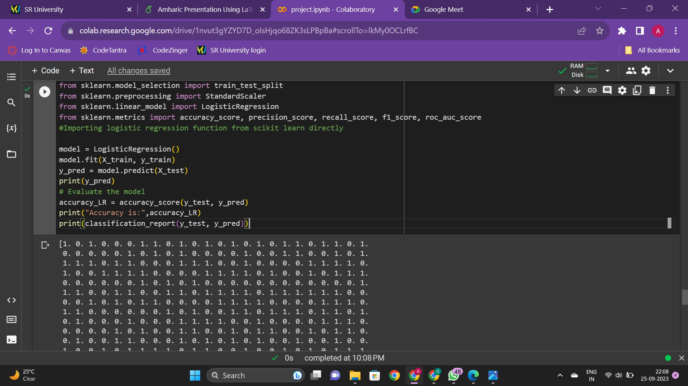
2203A52007 (SR)
Water Quality Prediction
Nov , 08 , 2023
18 / 36

Slide 19
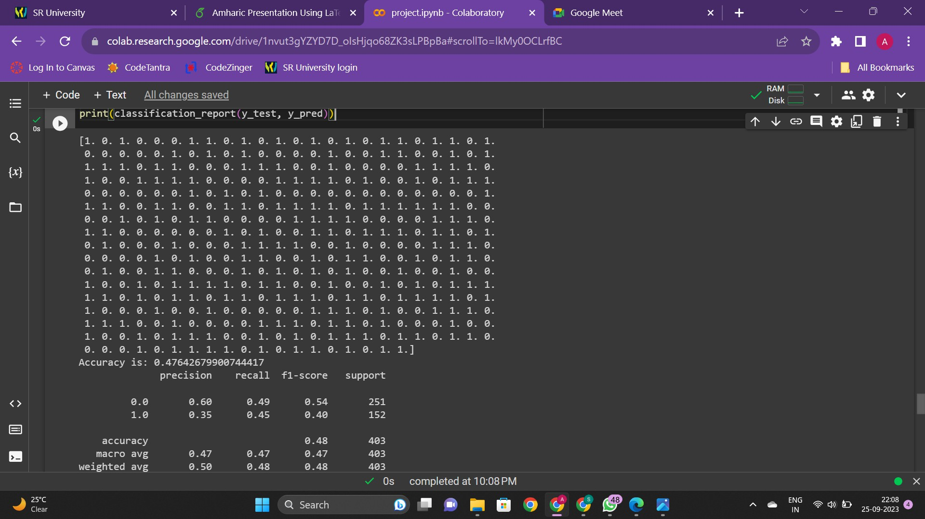
2203A52007 (SR)
Water Quality Prediction
Nov , 08 , 2023
19 / 36

Slide 20
Frame Title
The code starts by importing the necessary libraries and initializing an instance of the LogisticRegression class.
The fit function is called on the LogisticRegression object with the training data X train and y train as parameters. This function
trains the logistic regression model on the training data.
The predict function is called on the LogisticRegression object with the test data X test as a parameter. This function predicts the target variable for the test data.
The predicted values are printed using the print function. The accuracy of the model is calculated using the accuracy score function from the scikit learn library and printed using the print function.
The classification report function from the scikit learn library is used to print a report of the precision, recall, and F1-score for
each class.
Water Quality Prediction

Slide 21
Support Vector Machine (SVM) is a powerful machine learning algorithm used for both linear and nonlinear classification tasks.
SVM
The objective of SVM is to find a hyperplane in an N-dimensional space that distinctly classifies the data points.
The hyperplane is the decision boundary that separates the data points of different classes in a feature space
SVMs can be used for a variety of tasks such as text classification, image classification, spam detection, handwriting identification,
gene expression analysis, face detection, and anomaly detection
SVMs are adaptable and efficient in a variety of applications because they can manage high-dimensional data and nonlinear relationships
SVMs work by finding the maximum separating hyperplane between the different classes available in the target feature.
Water Quality Prediction

Slide 22
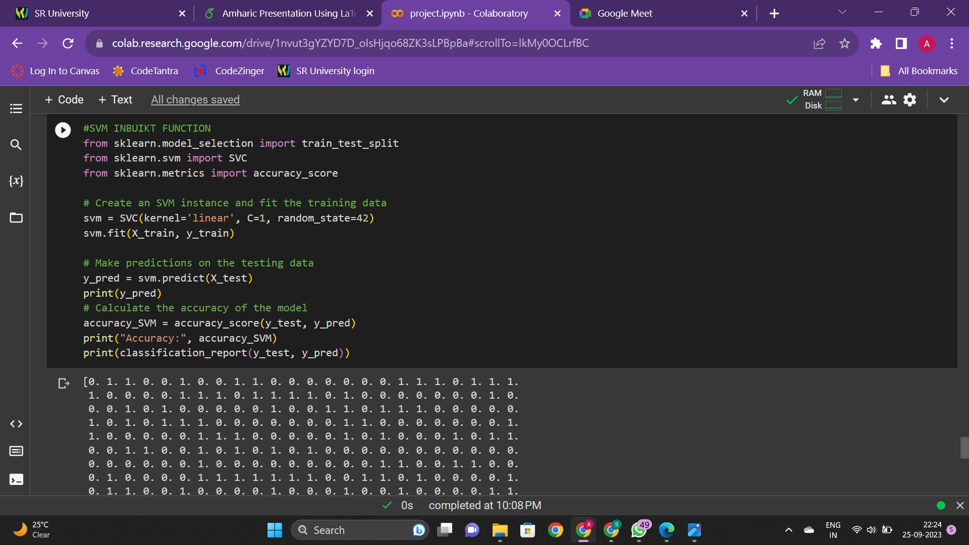
SVM Implementation
Water Quality Prediction

Slide 23
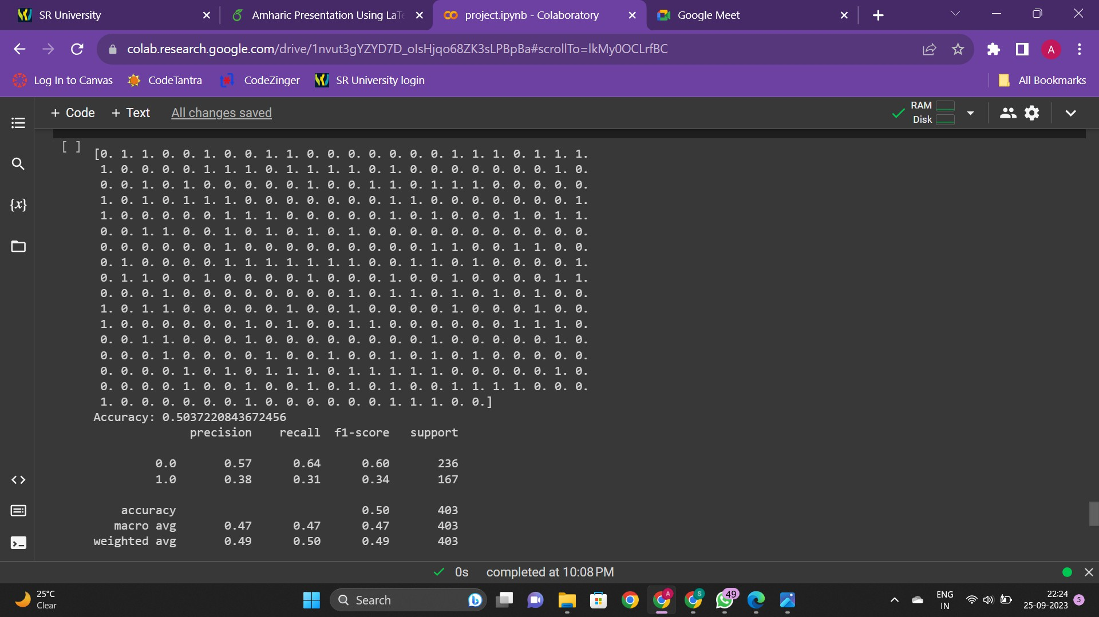
Water Quality Prediction

Slide 24
The code starts by importing the necessary libraries and initializing an instance of the SVC class from the scikit learn library.
The fit function is called on the SVC object with the training data X train and y train as parameters. This function trains the SVM model on the training data.
The predict function is called on the SVC object with the test data X test as a parameter. This function predicts the target variable for the test data.
The predicted values are printed using the print function.The accuracy of the model is calculated using the accuracy score function from the scikit learn library and printed using the print function.
The classification report function from the scikit-learn library is used to print a report of the precision, recall, and F1-score for
each class.
Water Quality Prediction

Slide 25
About KNN
K-Nearest Neighbors (KNN) is a simple, non-parametric machine learning algorithm used for both classification and regression. It operates based on instance-based learning, determining the classification of a new data point by comparing it with the majority class of its k nearest neighbors.
KNN computes the distance (usually Euclidean distance) between the input data point and all other points in the dataset. The k closest data points are then chosen based on these distances.
For classification, once the k nearest neighbors are identified, the majority class among these neighbors determines the class of the new data point. This means the most common class among the k neighbors is assigned to the new point.
It works well with small to medium-sized datasets but might not be the most efficient for large datasets.
Water Quality Prediction

Slide 26
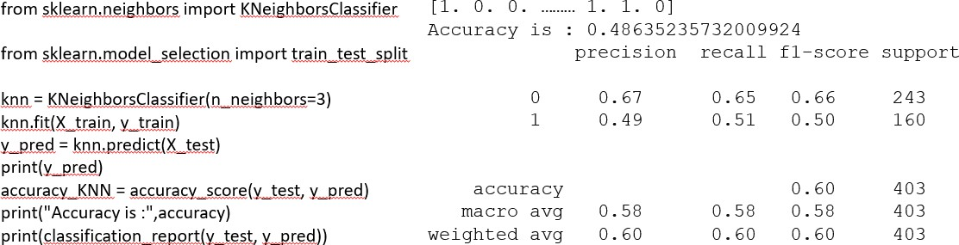
KNN Implementation
KNN Code with classification report
Water Quality Prediction

Slide 27
The code starts by importing the necessary libraries and initializing an instance of the KNeighborsClassifier class from the scikit learn library,creates a KNN classifier object with 3 as the number of neighbors.
The fit function is called on the knn object with the training data X train and y train as parameters. This function trains the knn model on the training data.
The predict function is called on the knn object with the test data X test as a parameter. This function predicts the target variable for the test data.
The predicted values are printed using the print function.The accuracy of the model is calculated using the accuracy score function from the scikit learn library and printed using the print function.
The classification report function from the scikit-learn library is used to print a report of the precision, recall, and F1-score for
each class.
Water Quality Prediction

Slide 28
About Bootstrap sampling
The bootstrap method is a resampling technique that involves repeatedly drawing random samples (with replacement) from a given dataset to estimate statistical properties and assess the performance of models.
In the context of a water quality prediction dataset, the bootstrap method can be used to gain insights into the dataset’s characteristics, evaluate the performance of predictive models, and estimate uncertainties.
The first step in the bootstrap method is to resample the original water quality prediction dataset.
Model performance assessment is one of the primary uses of the bootstrap method.Performance metrics (e.g., accuracy, precision, recall, F1-score) are calculated for each model’s predictions on the resampled data.
Water Quality Prediction

Slide 29
The bootstrap method can be used to estimate the importance of features in your water quality prediction model. This is especially relevant if you have a large number of potential input features.
The bootstrap method is a powerful tool for understanding the characteristics of water quality prediction datasets, evaluating model performance, estimating uncertainties, and gaining insights into the stability and importance of features and parameters. It
helps you make more informed decisions when developing and deploying predictive models for water quality assessment.
Water Quality Prediction

Slide 30
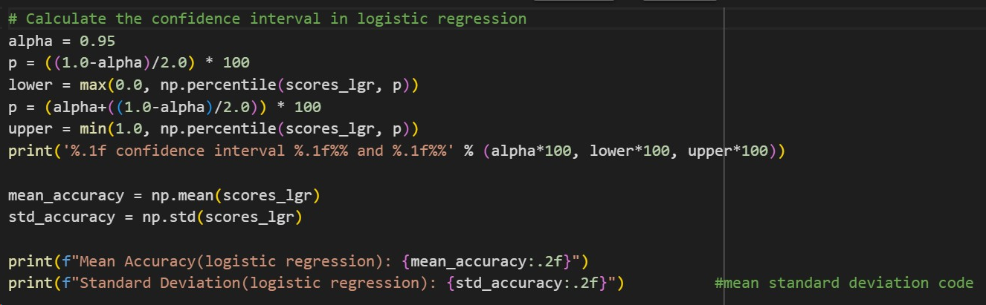
Assessing Performance of Models
Logistic Regression:
The code sets a confidence level, alpha, to 0.95 (indicating a 95 percent confidence interval).
Mean and Standard deviation provide insights into the central tendency and variability of the model’s accuracy across cross-validation folds.
30 / 36

Slide 31
Perceptron Model:
95.0 confidence interval 44.0 and 57.1
Mean Accuracy(perceptron model): 0.51
Standard Deviation(perceptron model): 0.04
Logistic Regression:
95.0 confidence interval 44.7 and 54.8
Mean Accuracy(Logistic Regression): 0.50
Standard Deviation(Logistic Regression): 0.03
SVM Classifier:
95.0 confidence interval 44.0 and 59.0
Mean Accuracy(SVM Classifier): 0.51
Standard Deviation(SVM Classifier): 0.004
KNN Classifier:
95.0 confidence interval 56.9 and 63.3
Mean Accuracy(KNN Classifier): 0.60
Standard Deviation(KNN Classifier): 0.02
31 / 36

Slide 32
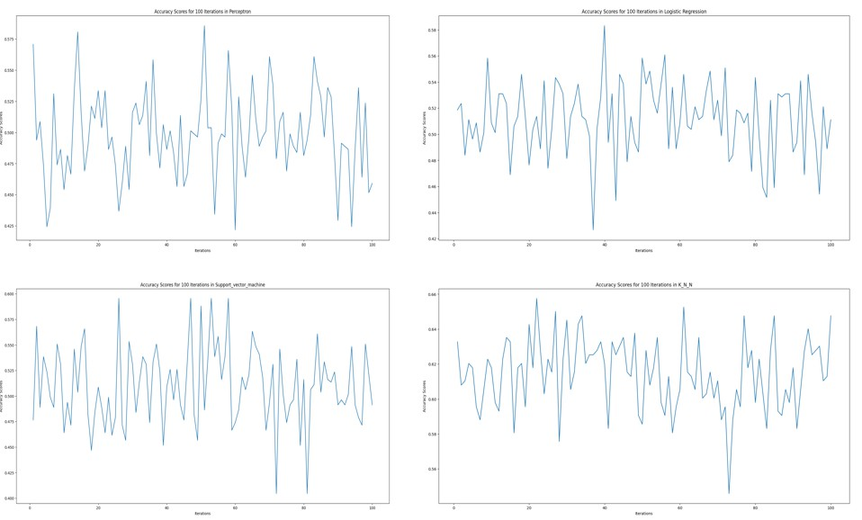
Bootstrap Accuracies vs Iterations
Water Quality Prediction

Slide 33
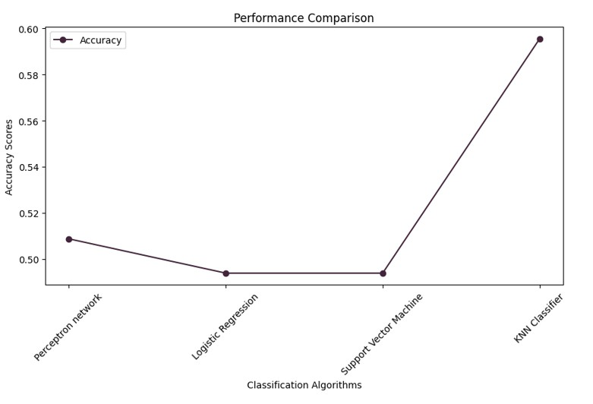
Performance Comparison
Water Quality Prediction

Slide 34
Conclusion
In conclusion the KNN model performed the best overall, achieving the highest accuracy and perfect precision, recall, and F1-score. It seems to have correctly classified all instances in the test set.
Both the Logistic Regression and SVM models had almost same accuracy and classification metrics, scoring consistently across precision, recall, and F1-score.
The Perceptron Classifier, while slightly higher in accuracy compared to the Logistic Regression and SVM models.
Most Fluctuating Model: Perceptron model
Most Consistent Model: KNN Classifier
Water Quality Prediction

Slide 35
Github Link
Review 2 of capstone project is posted here Github link is attached here: Click here
Water Quality Prediction

Slide 36
THANK YOU
2203A52007 (SR)
36 / 36
Water Quality Prediction
Nov , 08 , 2023

